Slide 1


Slide 2

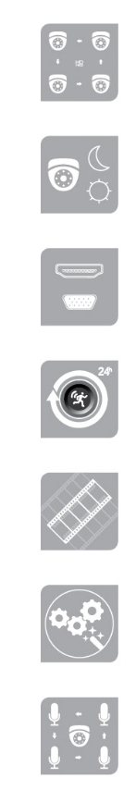
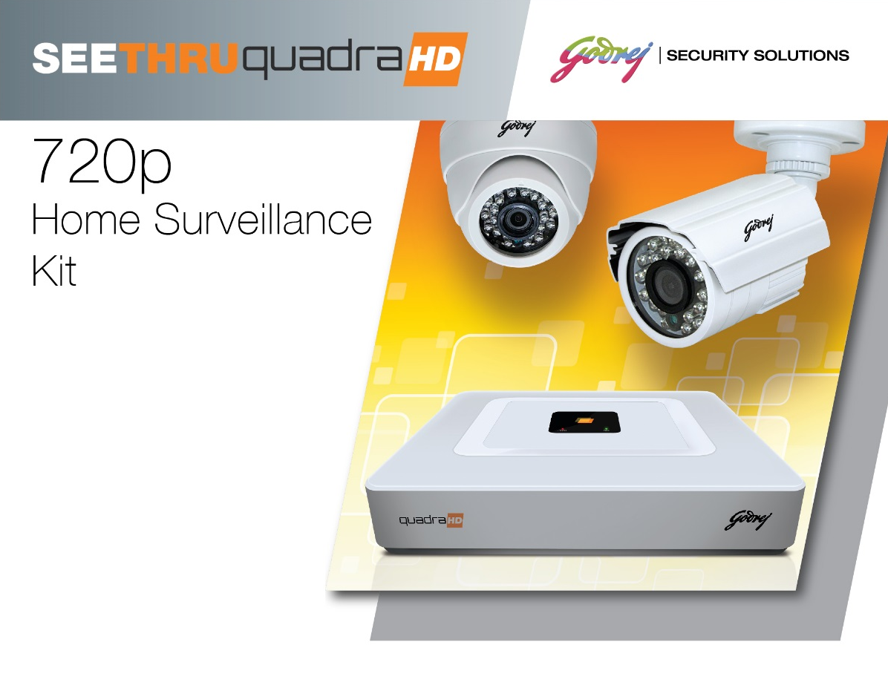
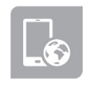
Seethru Range of Home Surveillance Systems
Connect upto 4 CCTV cameras to record 720p HD quality video
Day and night monitoring and recording
Can connect to HDMI/ VGA compatible monitors
24 hour recording and record on motion detection
Capture rate of 25 frames per second for higher event capturing accuracy
User friendly interface
Can connect upto 4 microphones
Realtime monitoring of video feed over mobile app and internet
KIT CONTENT – Digital Video Recorder with 1 TB Memory, Indoor Camera, Outdoor Camera, HDMI cable, CCTV cable, mouse and Viewing Software

Slide 3
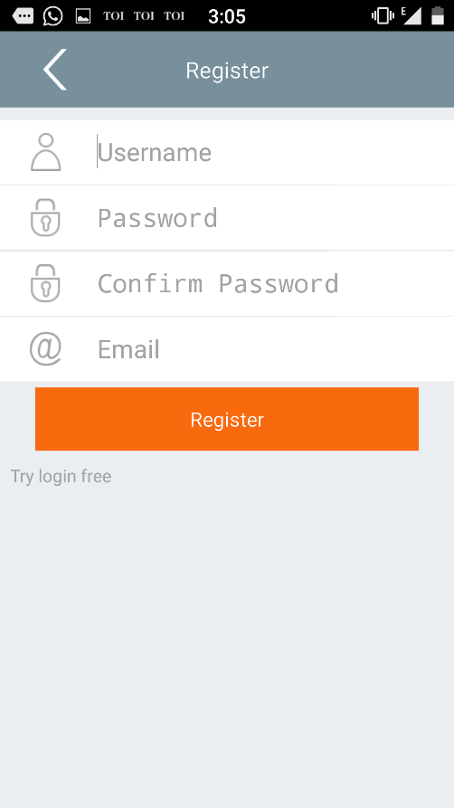
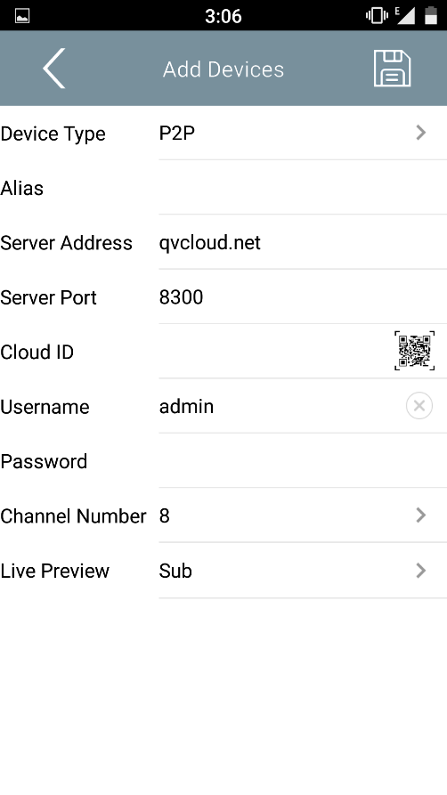
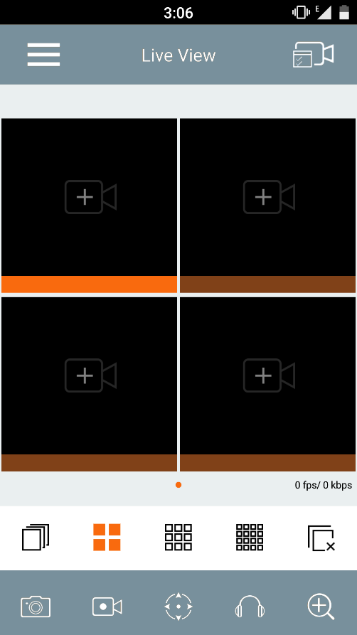
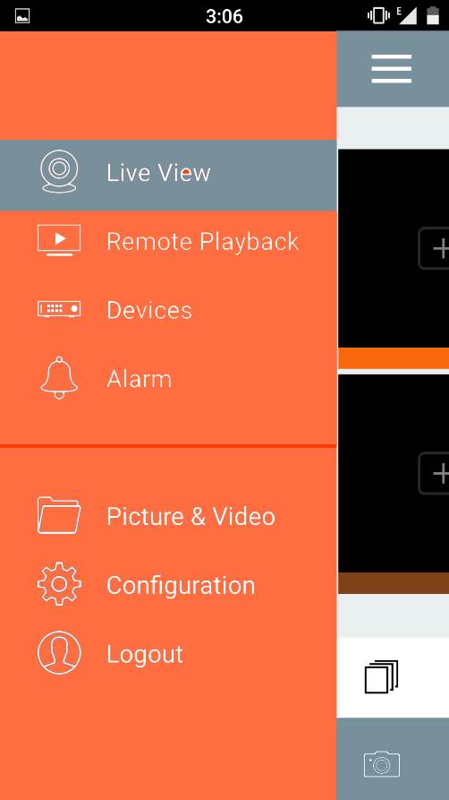
Seethru Range of Home Surveillance Systems
Mobile Application for Remote Viewing the video feed over internet using Smart Phone
Screenshots from the SEETHRU mobile app for the surveillance system

Slide 4
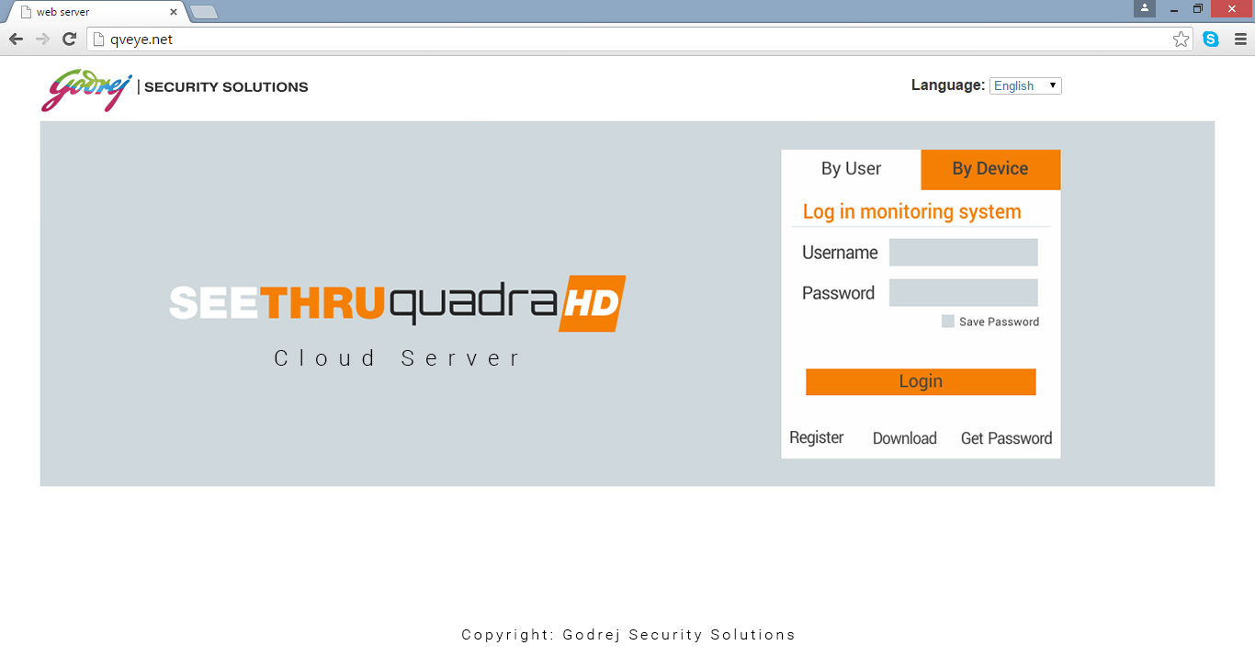
Seethru Range of Home Surveillance Systems
Web Server for Remote Viewing the video feed over internet using laptop
Screenshot of the SEETHRU cloud server for the surveillance system

